Slide 1
Innovative Projects- Arduino Using Embedded ‘C’ (CSE1002) Phase –II Review Presentation Waste Water Management Using Arduino
Submitted to the Presidency University, Bengaluru in partial fulfillment of the requirements for the Innovative Project- Arduino Using Embedded ‘C’
By
IPA-435
Under the supervision of
Dr.Vikas Kumar Assistant Professor Department of School ofEngineering April , 2023
Name | Roll Number
Shubham Kumar | 20221CSE0721
Kiran T B | 20221CSE00686
Gurupadeshwar | 20221CSE0672
Rohan S Naik | 20221CCS0108
Umesh Methri
20221CIT0147

Slide 2
Project Brief Summery
Water is a critical resource for agriculture and has not been well managed in India. The waste water management project aims to design and develop a system that can monitor and manage the quality of waste water using an Arduino microcontroller. The foremost aim of this project includes the estimation of water quality parameters like PH, Turbidity, Temperature that helps to identify the deviations in parameters and provides an alert message when there's an abnormal level. The outcomes of the project is a system that can measure the quality of waste water in real-time and provide information to users when water quality falls below acceptable levels.

Slide 3
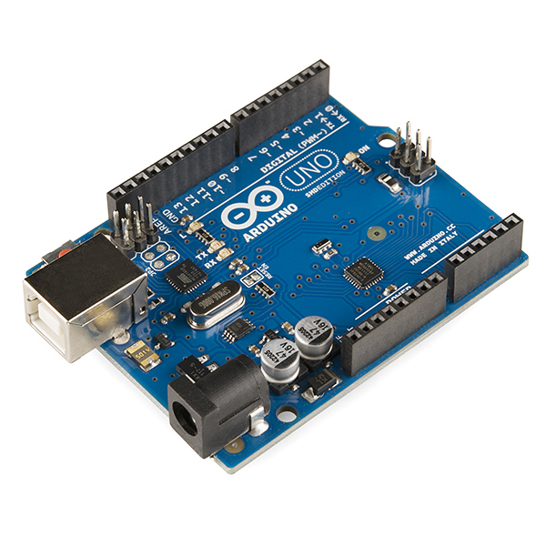
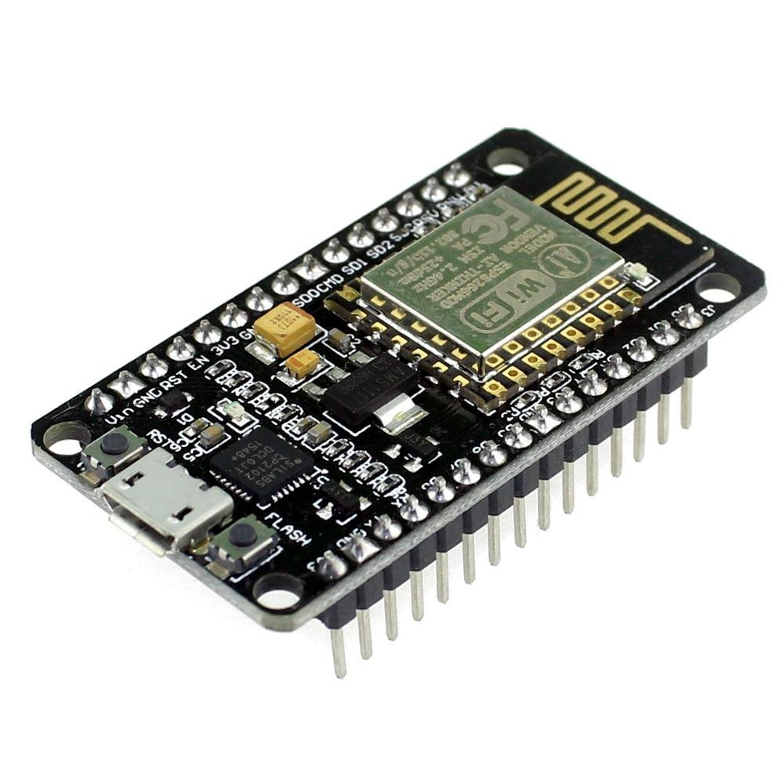
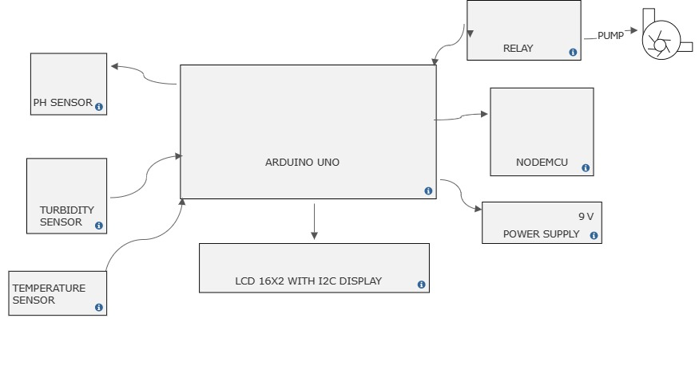
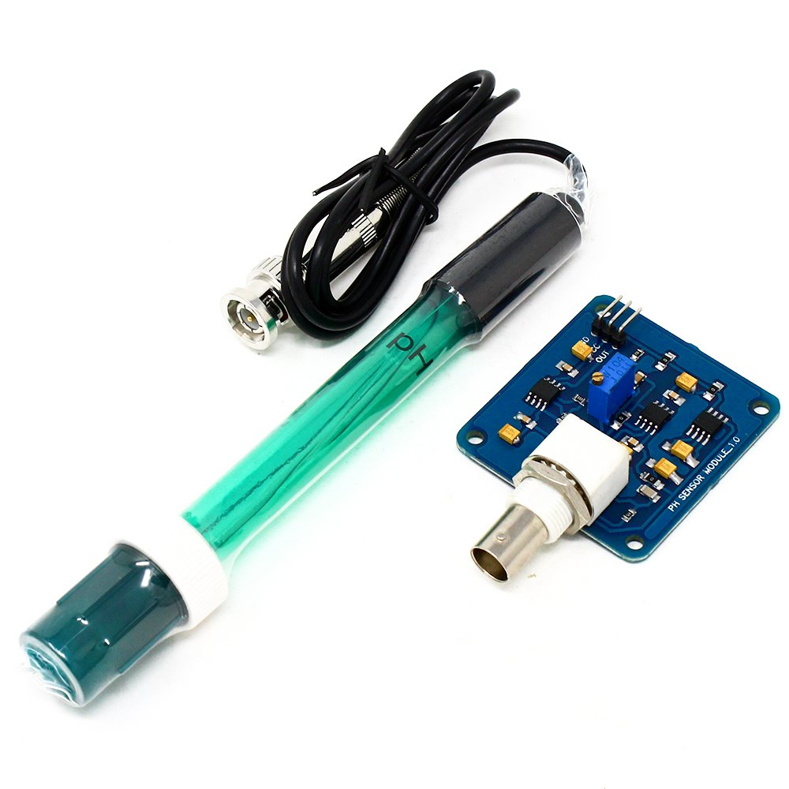
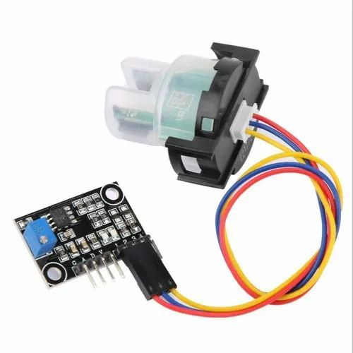
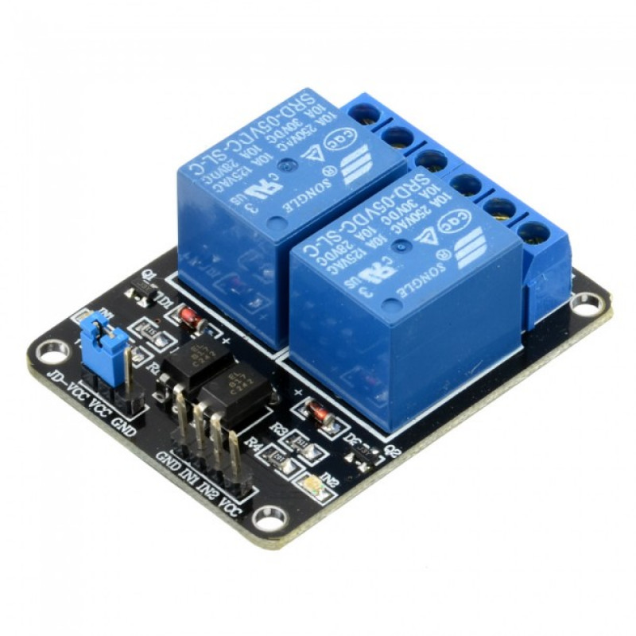
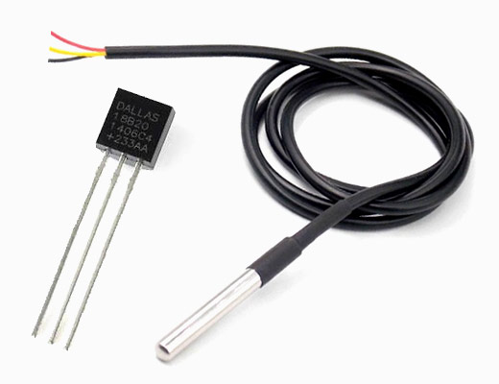
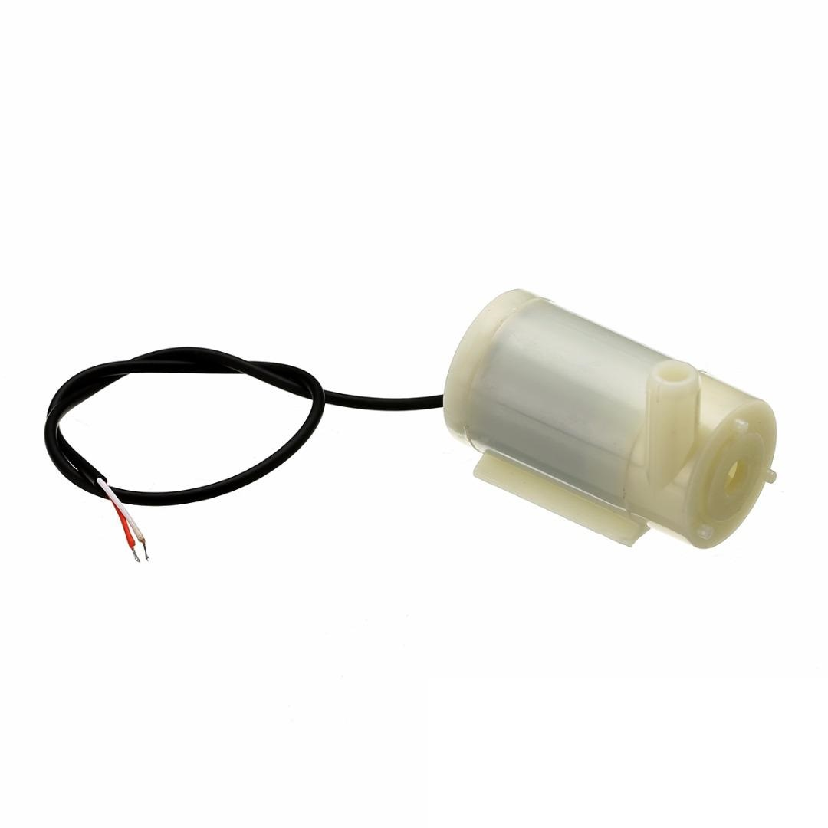
Circuit/Block Diagram
Arduino Uno
Nodemcu
pH sensor
Turbidity sensor
Relay
Temperature sensor
Motor pump

Slide 4
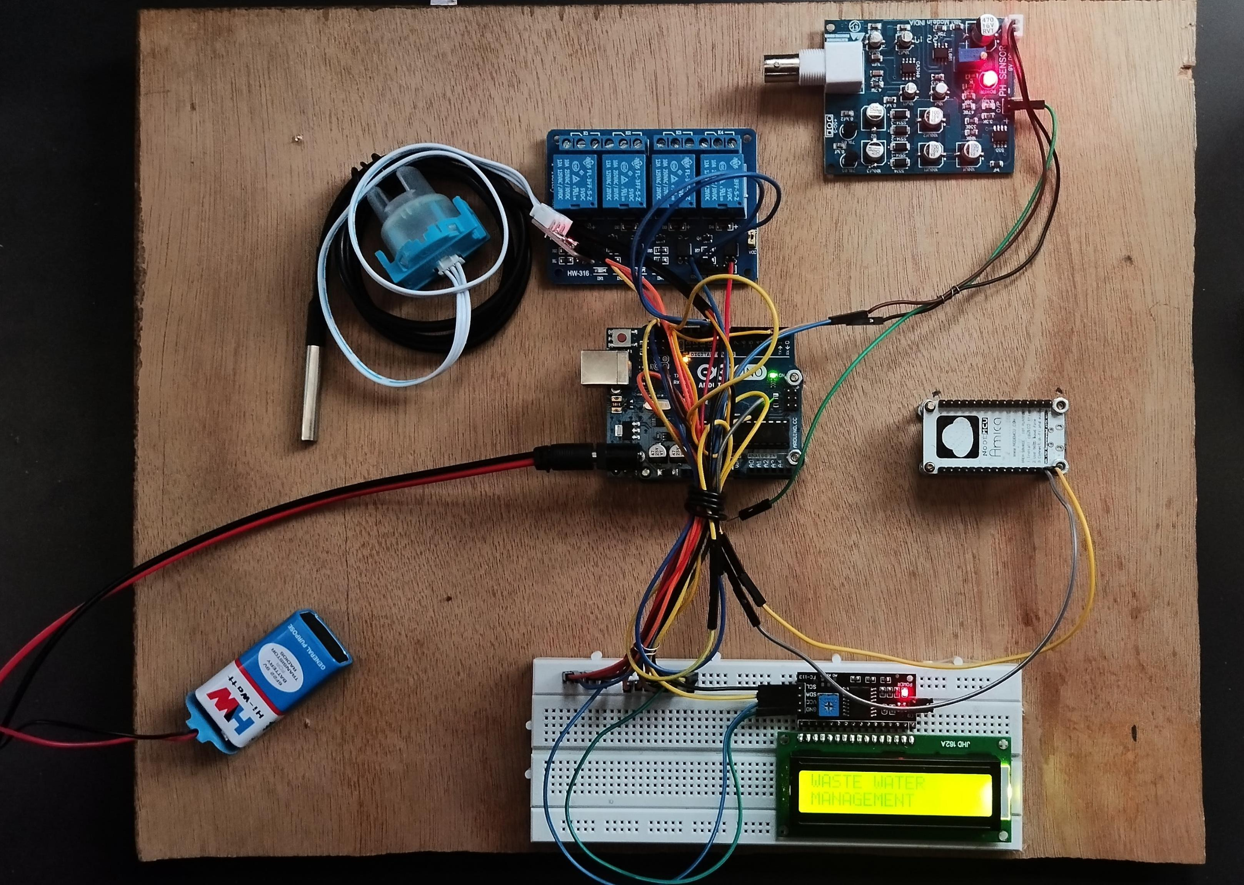
Obtained Results.

Slide 5
Challenges Faced in Project
Challenges faced: •The arduino circuit pins and wiring connections was a completely new and unfamiliar concept to us.
•Due to continuous classes our team was unable to arrange offline meeting. •Writing the program code according to the respective connections made on the arduino board with other components, which is different from normally followed coding procedure(or style).

Slide 6
Project Timeline
Note: Write in the below table what u have achieved in each phase and what you will be achieving before phase 3
Phase 1
25/03/2023
•Define the project scope and requirements.
•Design the circuit diagram and system architecture.
Phase 2
29/04/2023
•Select the hardware components, such as sensors and microcontrollers.
•Assemble the hardware components and build the circuit.
Phase 3
25/05/2023
•Install the system in the target location(s).
•Monitor the
System for data accuracy and performance.
•Fully working
Prototype of this project.

Slide 7
Q&A

Slide 8
Thank you !!

